Slide 1

Processing Tweets and Analyzing sentiments for Business Insights
By: SPARKS
Onkar Suhas Samant
Pravallika Mulukuri
Stephen O. Yeboah
Mohammed Nifaullah Sailappai

Slide 2

Table of Contents
GOAL
WORKFLOW
TECHNOLOGIES and ALTERNATIVES
DEMO
RECOMMENDATIONS and FUTURE SCOPE

Slide 3

GOAL
Using Apache Spark to process and analyze Tweets and perform sentiment analysis on two tv series
Billions of people Tweet everyday, analyzing these tweets has an enormous value for the businesses
Apache Spark is an open-source distributed general-purpose cluster-computing framework. It is ideal for processing large amount we have at hand
We analyze Tweets primarily from two TV Shows:
Money Heist
Tiger King
Furthermore, we also do sentiment analysis of every Tweet using Python libraries

Slide 4

WORKFLOW
Data Extraction
Crawled data from Twitter using a library in Python
Data Storage
Stored data in a MySQL database on Google Cloud
Data Processing & Analysis
Connected to the MySQL DB
Stored the data in a file format
Created a Schema for the table
Processed data using Spark SQL
Advanced Analysis
Cleaned data using NLTK
Visualized data using Seaborn
Sentiment Analysis of Tweets using TextBlob
Analyzed basic metrics using Spark SQL and PySpark DatFrame methods

Slide 5

TECHNOLGIES and ALTERNATIVES
Technologies used:
Data Extraction: Python library GetOldTweets3
Data Storage: MySQL database on Google Cloud
Data Processing and Basic Analysis: Spark SQL and PySpark DataFrame
Advanced Analysis: Python libraries like Seaborn, NLTK, TextBlob
Future Enhancements and Alternatives:
Other DBs / Platforms: HDFS, HBase, MongoDB, Kafka etc.
Processing and Analysis: MapReduce / Tez, Storm, Flink, etc.
Advanced Analysis: Word embedding approach in Keras/Tensorflow2, sentiment analysis / topic modeling in scikit-learn, etc.

Slide 6

Demo

Slide 7


Step 1 Data Extraction
Crawl Data from the Twitter with Get_Tweets_POC.ipynb python notebook
This downloads a maximum of 1000 tweets about series Money Heist and Tiger King in the last one week
The series name and time period is configurable
The output is a csv file

Slide 8
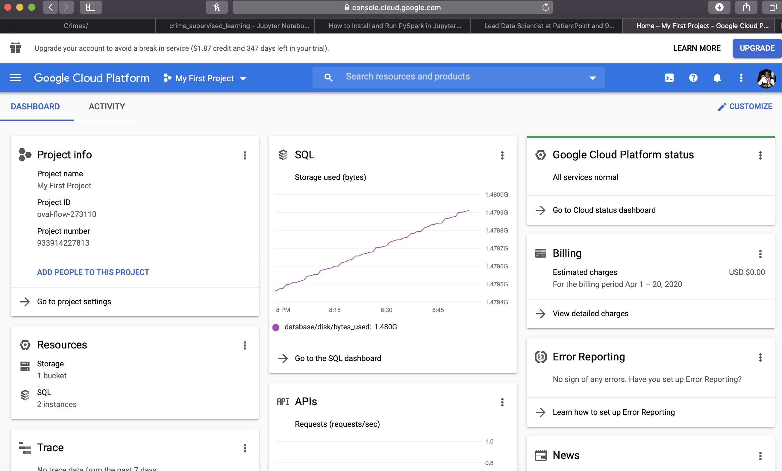

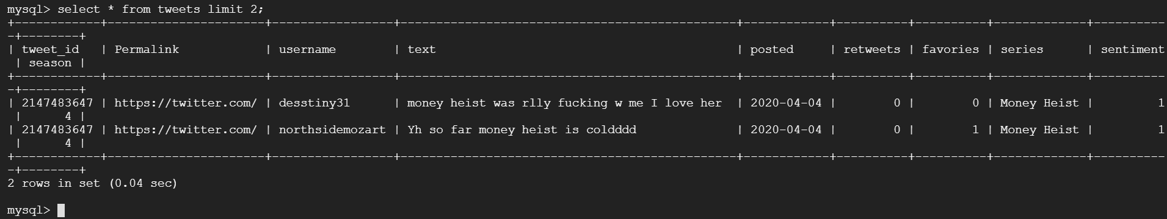
Step 2 Data Storage
Google’s Cloud Database is used to store data
A MySQL DB is created with required schema for storage

Slide 9

Step 3 Data Processing & Analysis
Processed data using PySpark
Basic Analysis and Metrics using PySpark SQL and PySpark DataFrame functions
Metrics:
Basic Metrics
Total Users: 13,018
Total Tweets: 14,000
Total Days: 7 days
Advanced Metrics (Popularity Metrics)
Average likes per Tweet
Money Heist: 4.3
Tiger King: 7.7
Average Retweets per Tweet
Money Heist: 0.7
Tiger King: 0.87

Slide 10

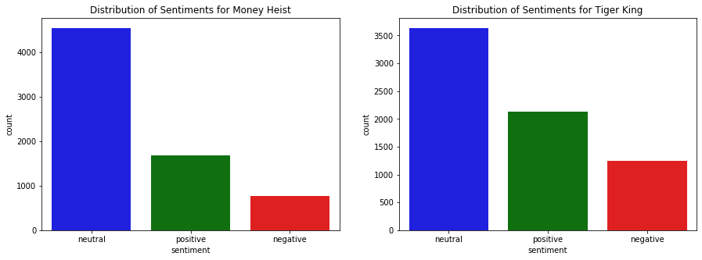
Step 4 Advanced Analysis
Cleaned data in Python with NLTK library
Sentiment Analysis of Tweets using TextBlob library

Slide 11
RECOMMENDATIONS & FUTURE SCOPE
Recommendations
The Pipeline can be deployed for larger / real-time data for data storage and analysis to drive decisions
Metrics give the sense of popularity, performance and trends which give very helpful insights
Sentiment analysis helps in judging the sentiments about the TV show which can be used for better TV Show recommendations and ideas for making shows in the future
This pipeline can be used for other use cases to drive other business decisions
Future Scope
More data can be fetched for more reliable judgments
Application of advanced pre-processing techniques suitable for Tweets
Advanced model development using Word Embeddings trained through a Neural Network Architecture
Could be extended to any topic, comparison of multiple subjects

Slide 12
Thank you

